Slide 1
Statistical learning project Gloria Villa (49117A)

Slide 2
Unsupervised learning

Slide 3

Smartphones Dataset
For this part of the project, a dataset about smartphones was choosen which contains 980 observations of 22 variables. The dataset included different smartphones features such as:
Battery capacity
Ram capacity
Screen size
Processor speed
Price and so on

Slide 4
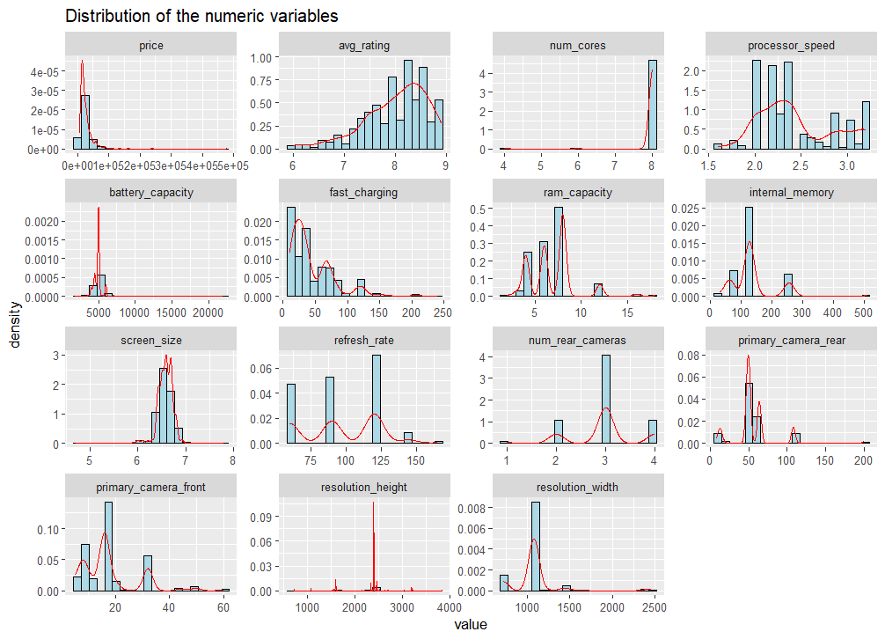
Exploratory data analysis (EDA)

Slide 5
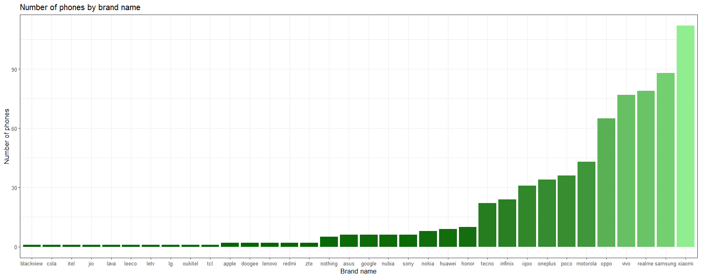
Exploratory data analysis (EDA)
Xiaomi, Samsung and Realme are the top three brands in terms of the number of smartphones counted in the dataset that belongs to them. The other brands have a significantly smaller representation in the datset.

Slide 6
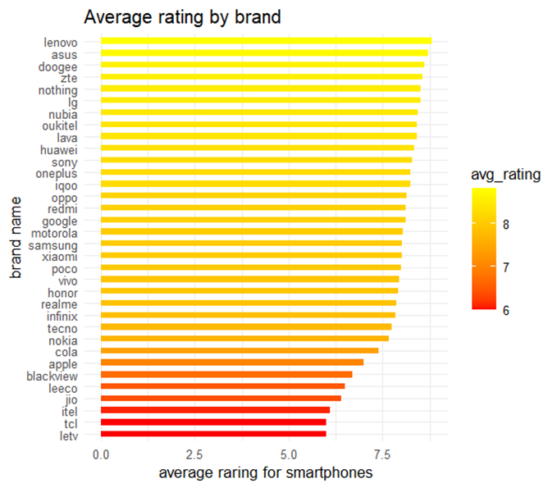
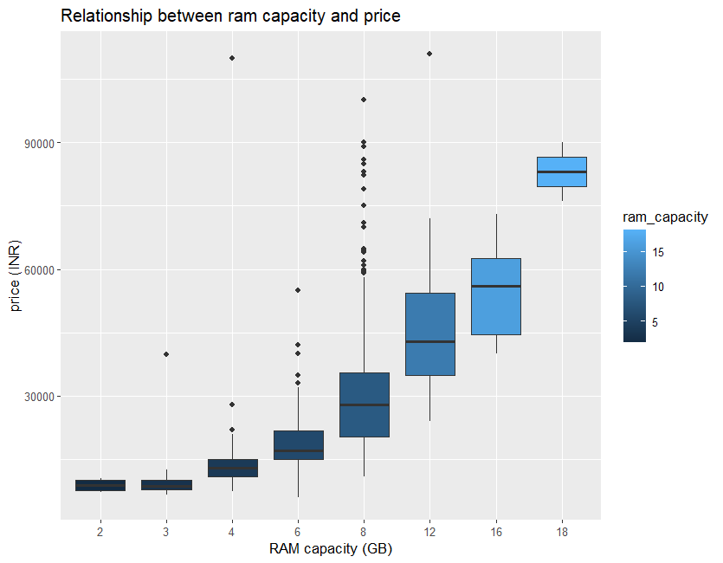
Exploratory data analysis (EDA)
This bar plot highlights how consumer satisfaction varies by brand and highlights the most popular smartphone’s brand based on the average rating.
The RAM capacity has a positive correlation with the prices of the smartphones, in fact, as the RAM capacity increases, also the price of the smartphones increases

Slide 7
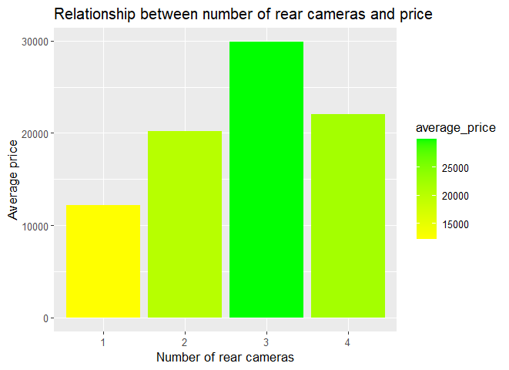
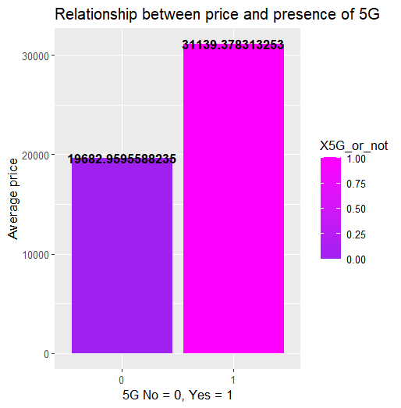
Exploratory data analysis (EDA)
Smartphones with 3 rear cameras show the highest average price, suggesting that this is a feature that higly influenze the price of the devices. However, this relationship is not perfectly linear since smartphones with 4 rear cameras have lower average price than the ones with only 3 cameras.
This suggests that the 5G is tipically present in more premium smartphone models since the average price increases if there is the 5G implemented on the smartphone.

Slide 8
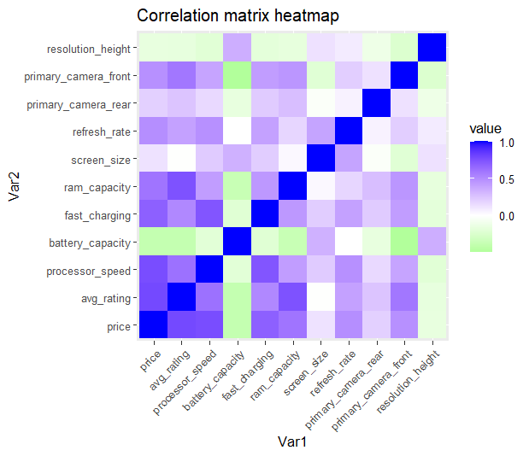
Exploratory data analysis (EDA)
The heatmap of the correlation matrix shows the strength of the relationships between the numerical features of the dataset. Strongest positive correlations with price: RAM capacity, processor speed, and screen size. Overall, most of the variables show moderate correlation with each other. This evaluation is important for identifying key variables for modelling and feature selection.

Slide 9
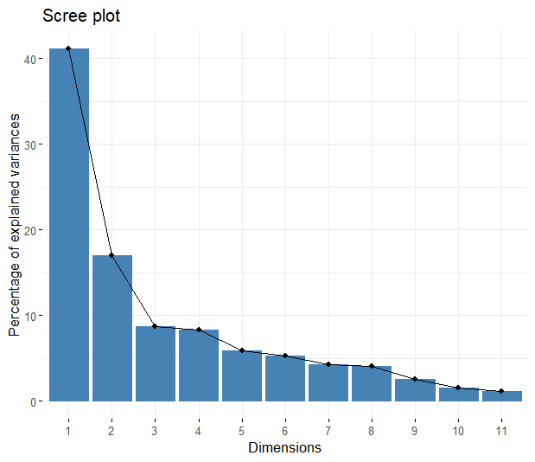
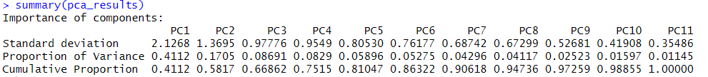
Principal component analysis (PCA)
Below there are the results of the principal componet analysis (PCA). The scree plot on the left is used to represent the portion of the variance explained by each principal component resulting from the PCA analysis.

Slide 10
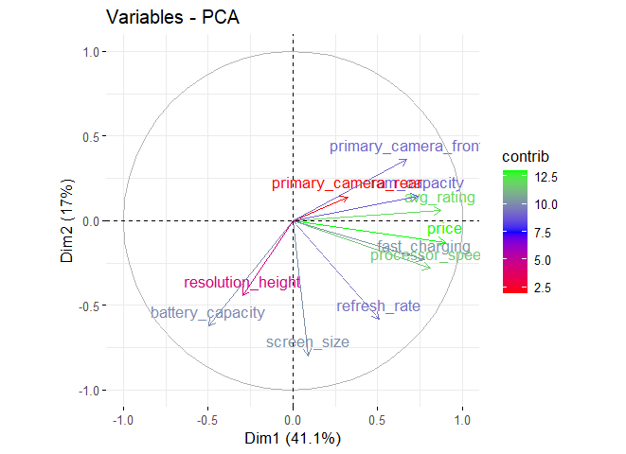
Variable contribution plot

Slide 11
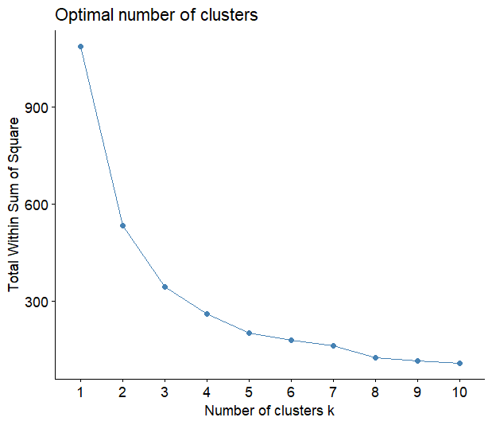
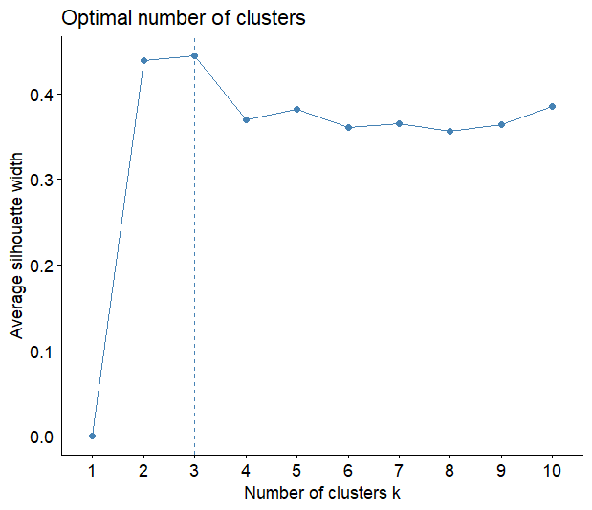
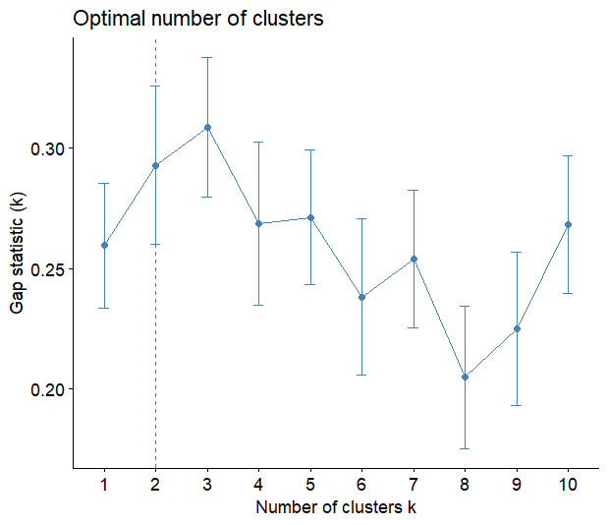
Clustering
WSS (Within sum of squares) method or “elbow method”
Silhouette method:
Gap method
From this analysis, the optimal number of clusters to retain should be between k = 2 and k = 3

Slide 12
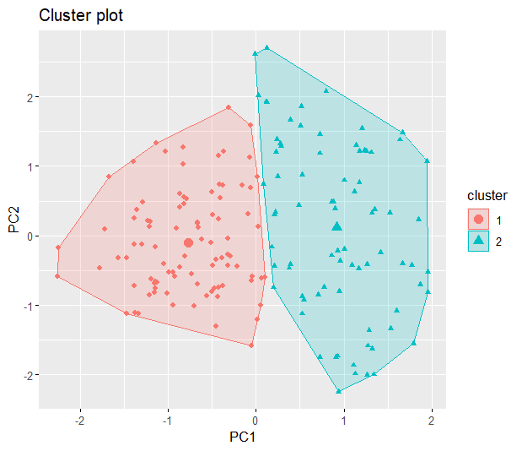
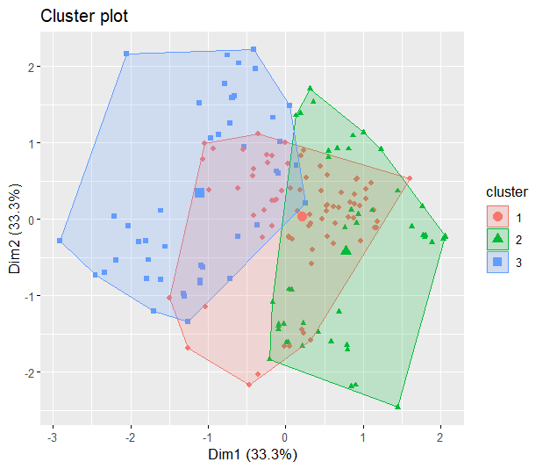
K - means
Classification results with k = 2
Classification results with k = 3
The K-means algorithm was applied with k = 2 and k = 3 to explore natural groupings. While k = 2 offers a clear separation, k = 3 provides more detailed segmentation, although with some overlap.

Slide 13
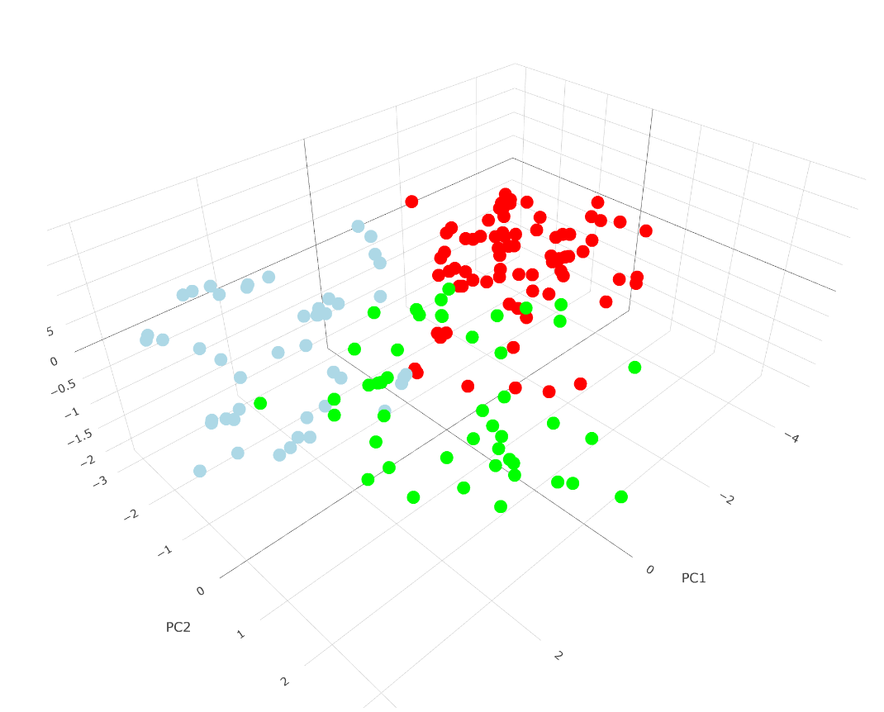
3D visualization of K – means with k = 3
Here’s a clearer visualization of the clusters separation for the case where k = 3 in a 3D form.

Slide 14
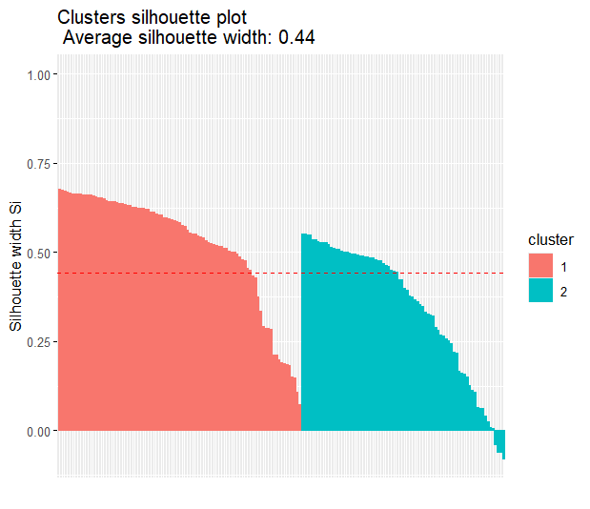
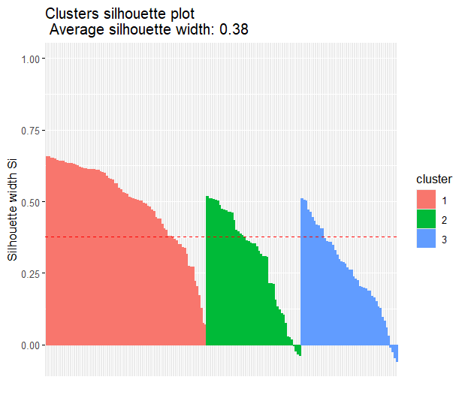
K – means silhouette score
K = 2
K = 3
We can see that for k = 2 we have a higher silhouette score, so the optimal number of clusters to be considered should be k = 2.

Slide 15
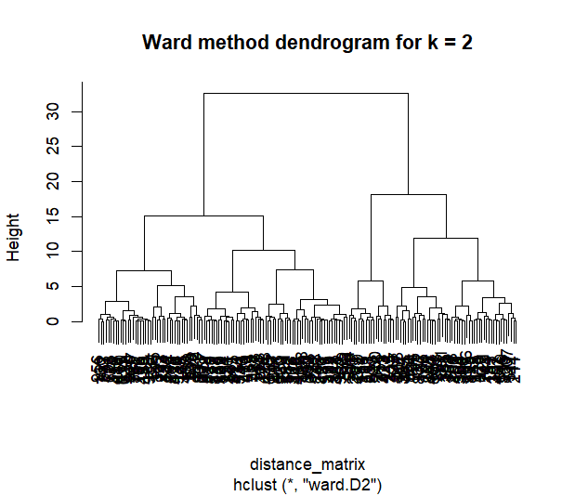
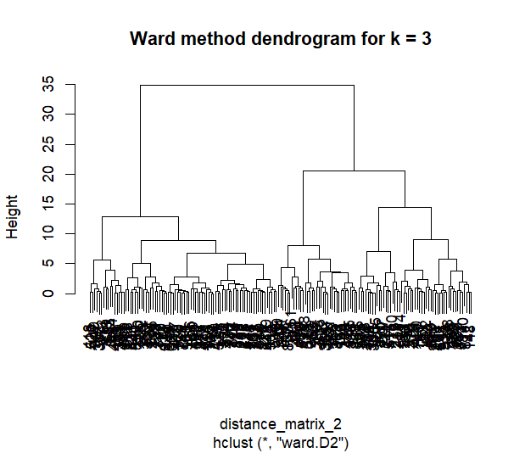
Hierarchical clustering

Slide 16

Results
For PCA, the optimal numer of principal components, which explain most of the vairance, is two
The optimal number of clusters is two
K – means with k = 2 is the most effective clustering method for this dataset

Slide 17
Supervised learning

Slide 18

Breast cancer Dataset
For this part of the project, a breast cancer dataset was chosen. This dataset contains 569 observations and 31 variables about various biological characteristics of cell nuclei derived from breast cancer mass images. Among them we have:
Diagnosis: it’s the target variable and it can be equal to M (malignant) and B (benign)
The remaining 30 numerical features are grouped in tree sets:
Mean values: like texture_mean, perimeter_mean, area_mean and radius_mean.
Standard error values: like smoothness_se, compactness_se and symmetry_se.
Worst case values: like radius_worst, concavity_worst and fractal_dimension_worst.

Slide 19
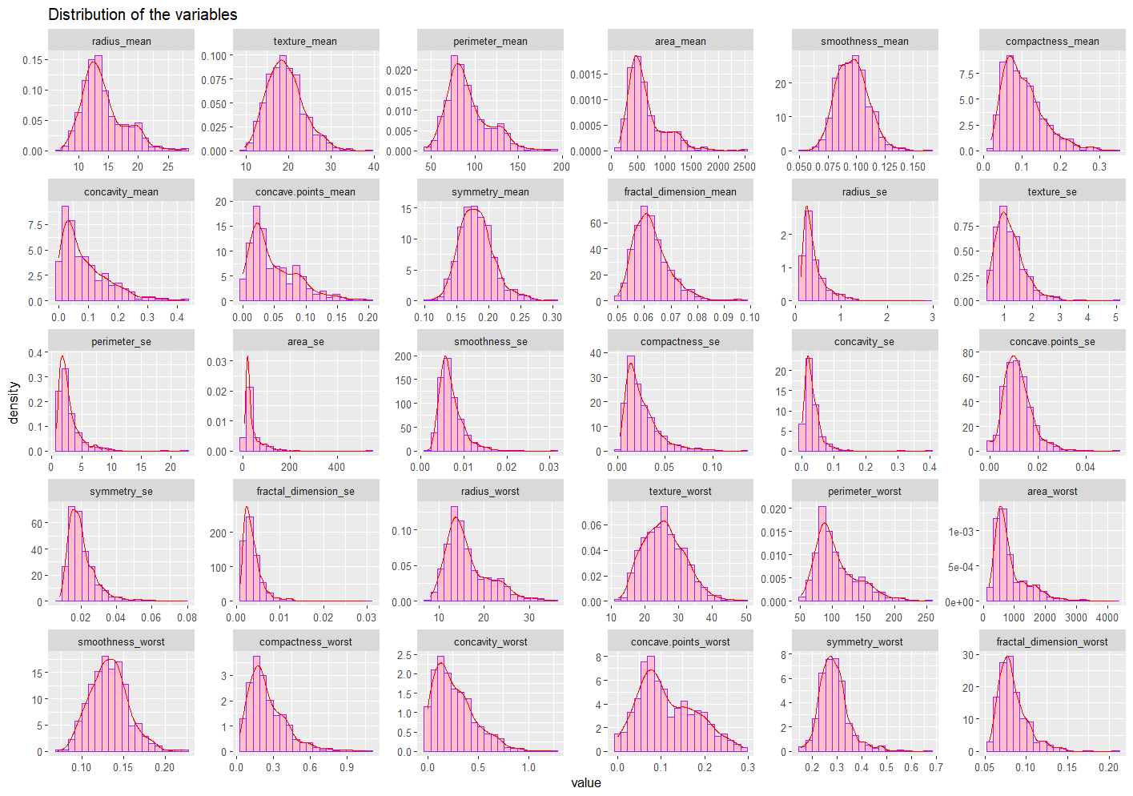
Exploratory data analysis (EDA)

Slide 20
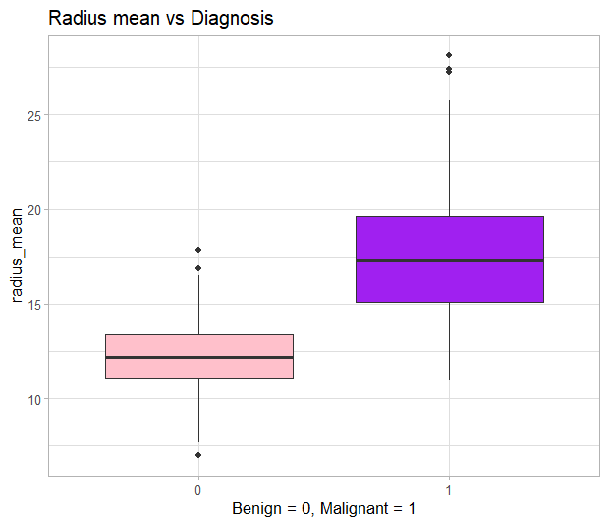
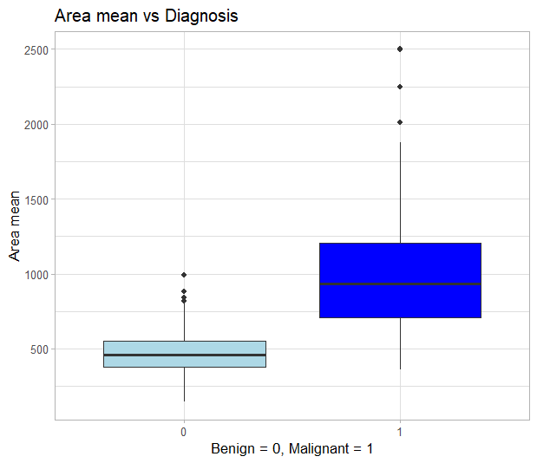
Exploratory data analysis (EDA)
Higher values of radius mean are strongly associated with the diagnosis of a malignant tumour
Malignant tumours tend to occupy a larger area , making area mean a key diagnostic feature

Slide 21
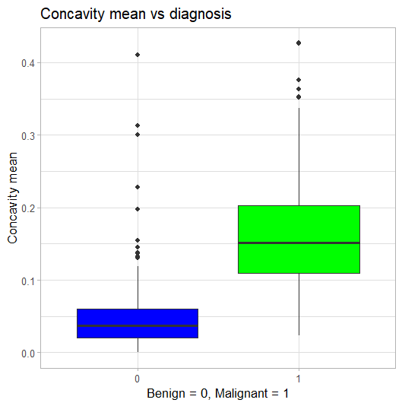
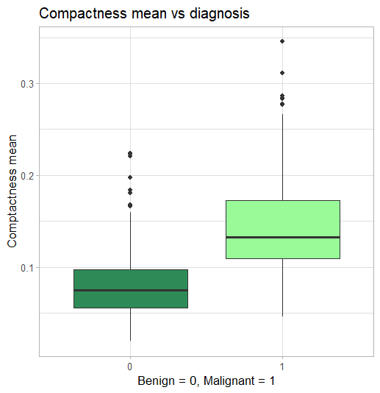
Exploratory data analysis (EDA)
Increased concavity mean indicates a more aggressive and irregular growth, which are two factors that influence the most the malignant diagnosis in the patients.
Malignant tumours show higher values of compactness, indicating a denser and more irregular growth patterns.

Slide 22
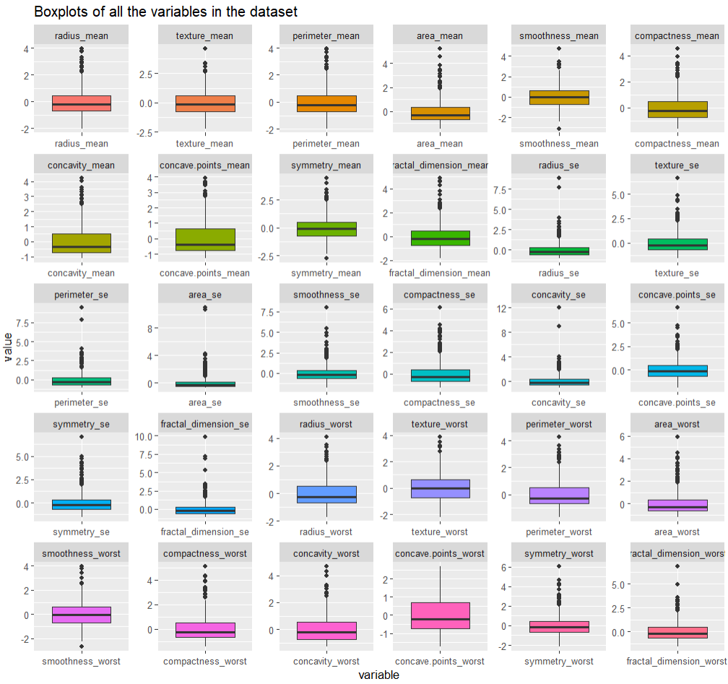
Exploratory data analysis (EDA)

Slide 23
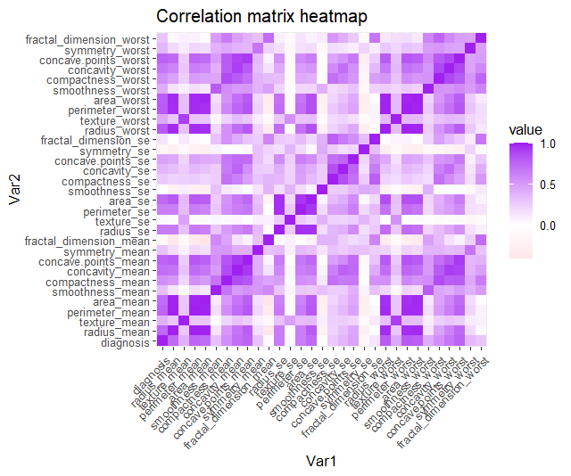
Exploratory data analysis (EDA)
The heatmap reveals strong correlations between several features. The ones represented below are the highest correlated variables which were removed from the dataset to avoid redundancy and potential bias in the learning algorithms used throught the analysis.

Slide 24
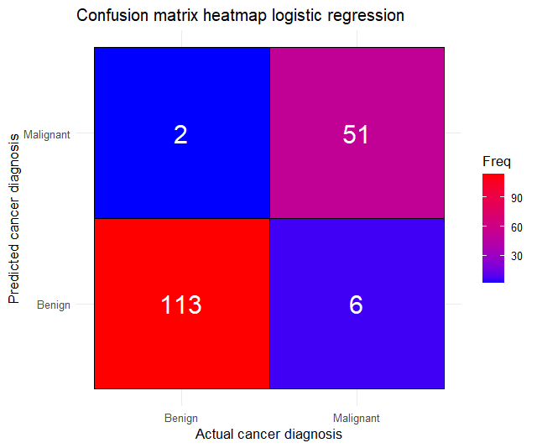
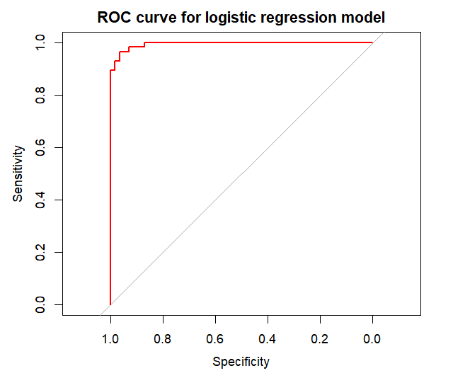

Logistic regression

Slide 25
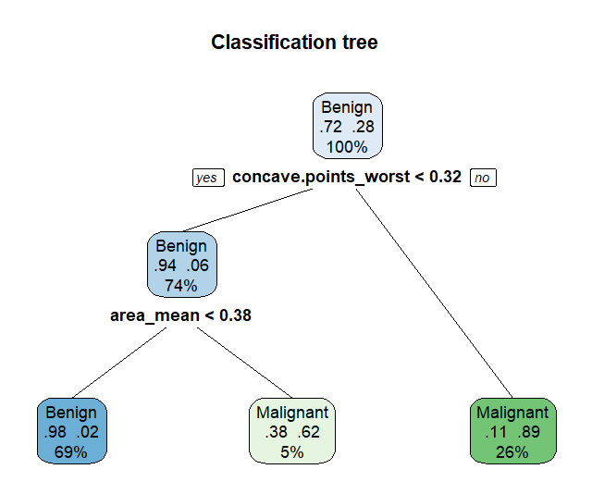
Decision tree

Slide 26
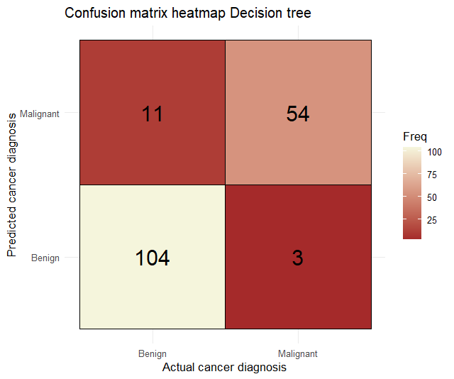
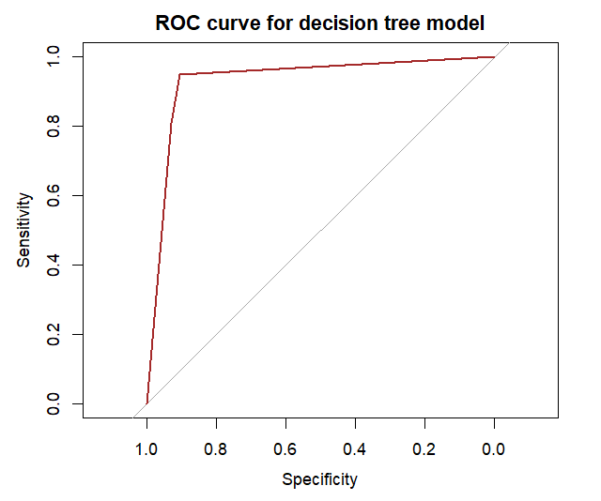

Decision tree

Slide 27
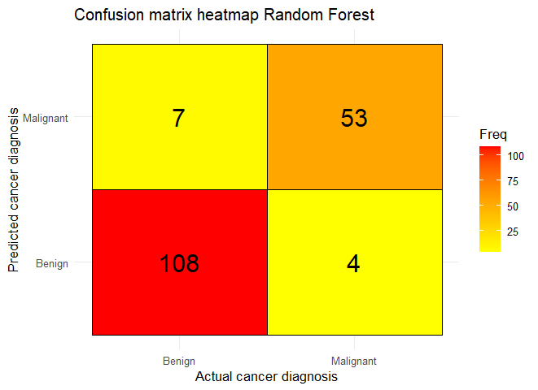
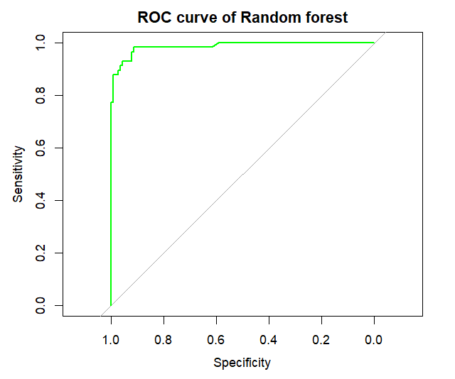

Random Forest

Slide 28
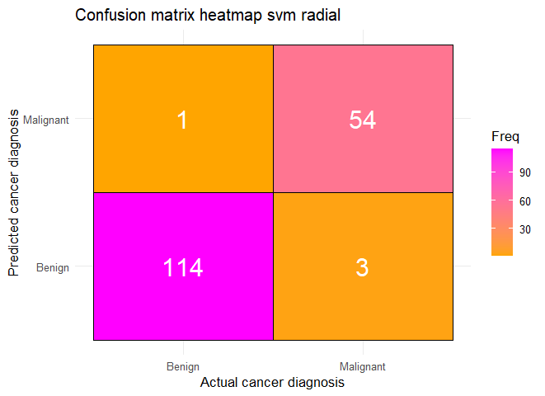
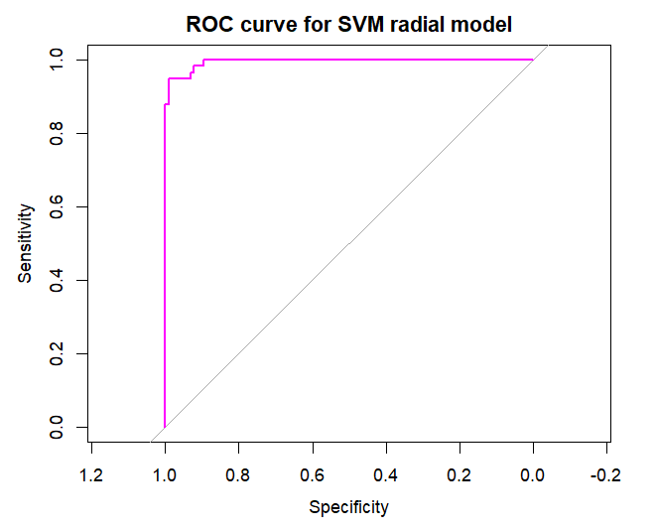
Support Vector Machines (SVM)
Support Vector Machines with radial, linear and polynomial basis functions were implemented, but the most accurate one among them was the one with the radial basis function:

Slide 29
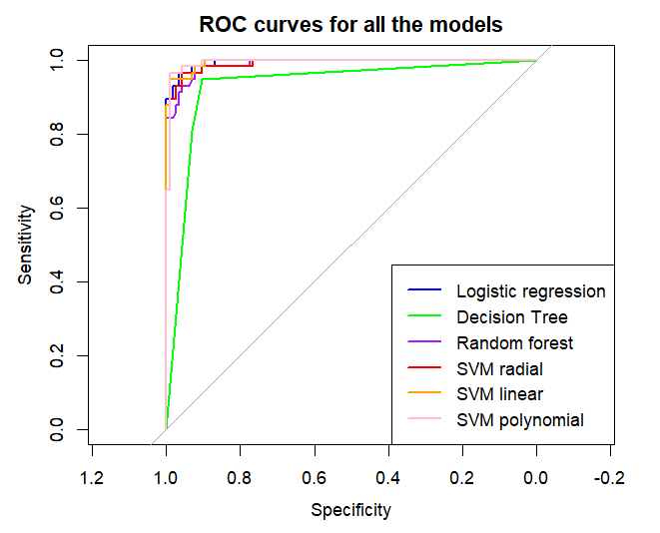
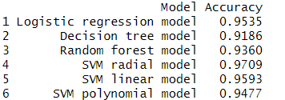
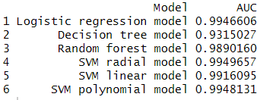
Models' comparison
From the AUC and Accuracy values and the respective ROC curve representations, we can say that the Support Vector Machines (SVM) with radial basis function is the most effective model for our classification task

